Slide 1
Java SE 17 – Presentation
Chapter 9 – Collections and Generics

Slide 2
Revision
- Collections is a set of ...
– ... is a framework ...
There are ... main type of ... we will study ...
+)
+)
+) ... is a special collections ... in certain order ... Deque is ... access
+)
- Map doesnt implement Collections because ... It requires special ...

Slide 3
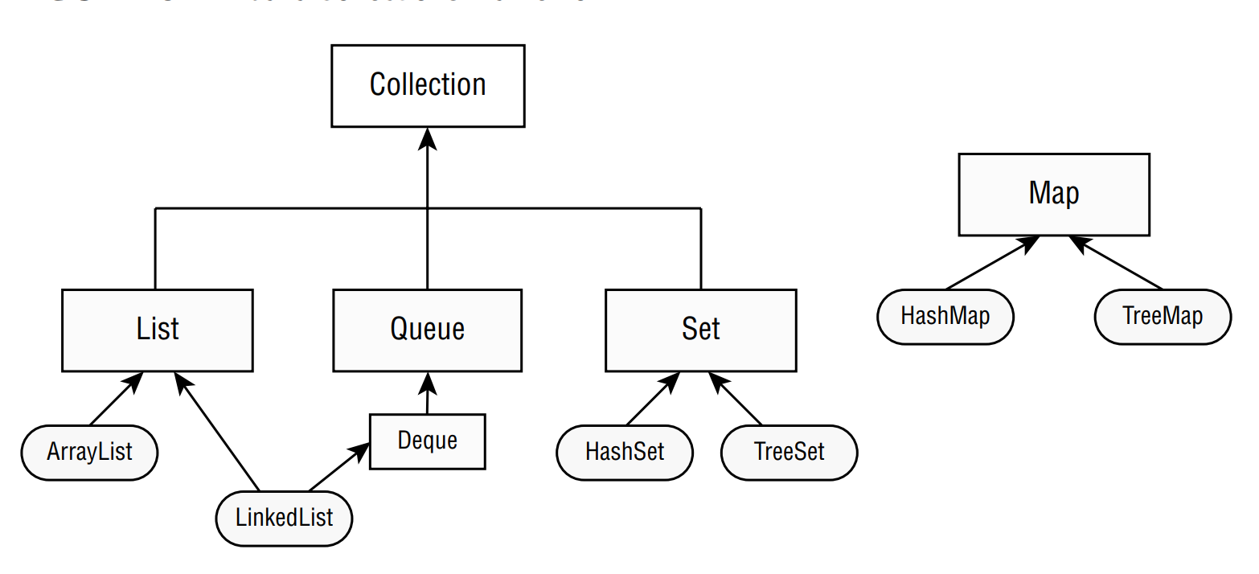
Revision
- In the next section we will ... method ... ArrayList and HashSet ...
Using the diamond operator
- Note: We can ..., but if we use it ... we must ...
Adding data add()
Removing data using remove()
- Note: ArrayList has ... versions => We must be careful when ...

Slide 4
Revision
Counting elements
isEmpty()
size()
Clearing the Collections
clear()
Check Contents
contains()
Removing with conditions
removeIf() will ... all ... if condition is .... This method has a ... as a parameter (we will explain the <? super E> later)
(code illustration snippet 1,2)

Slide 5
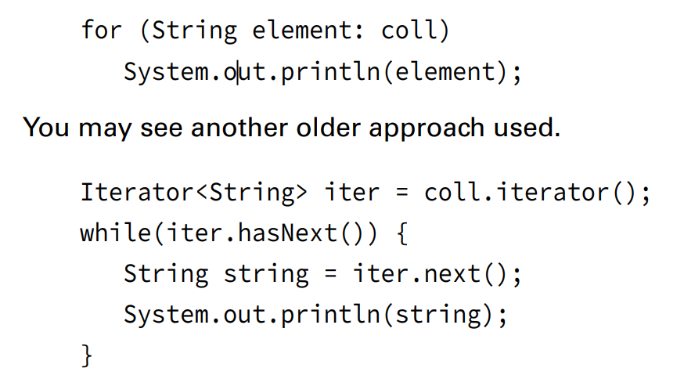
Revision
Iterating
- forEach() is used to .... It recieves a ... as a parameter ...
(code illustration snippet 3)
Determining Equality
the method equals() also has own ... for each ... (e.g ArrayList check ... while HashSet ...)
(code illustration snippet 4)
- Although Java protected us from ... we still ... (code illustration snippet 5)

Slide 6
Revision
Using the List interface
Comparing List implementation
Other than ArrayList, we have ... which is a ... ... and ...
LinkedList is special because it ...
It has all ... from ... and it also allows ...
The benefit ... time ... but .... linear
Creating a List with a Factory
We also have some ... (without ...)
Arrays.asList(varargs)
List.of(varargs)
List.copyof(collection)
(code illustration snippet 6)

Slide 7
Revision
Creating a List with a Constructor
- We have ... constructors for ...
(code illustration snippet 7)
– We have ... constructors for ...
(code illustration snippet 8)
- We can mix ... with ArrayList ...
(code illustration snippet 9)
- If we ... specify the ... in ... then Java will assume ...
(code illustration snippet 10,11)
Working with List method
﻿public boolean add(E element)
﻿public void add(int index, E element)

Slide 8
Revision
﻿public E get(int index)
﻿public E remove(int index)
﻿public default void replaceAll(UnaryOperator<E> op)
﻿public E set(int index, E e)
﻿public default void sort(Comparator<? super E> c)
(code illustration snippet 12,13)
- The following code is the reason why we need to be careful ...
(code illustration snippet 14)
- We can convert ... to ...
(code illustration snippet 15)

Slide 9
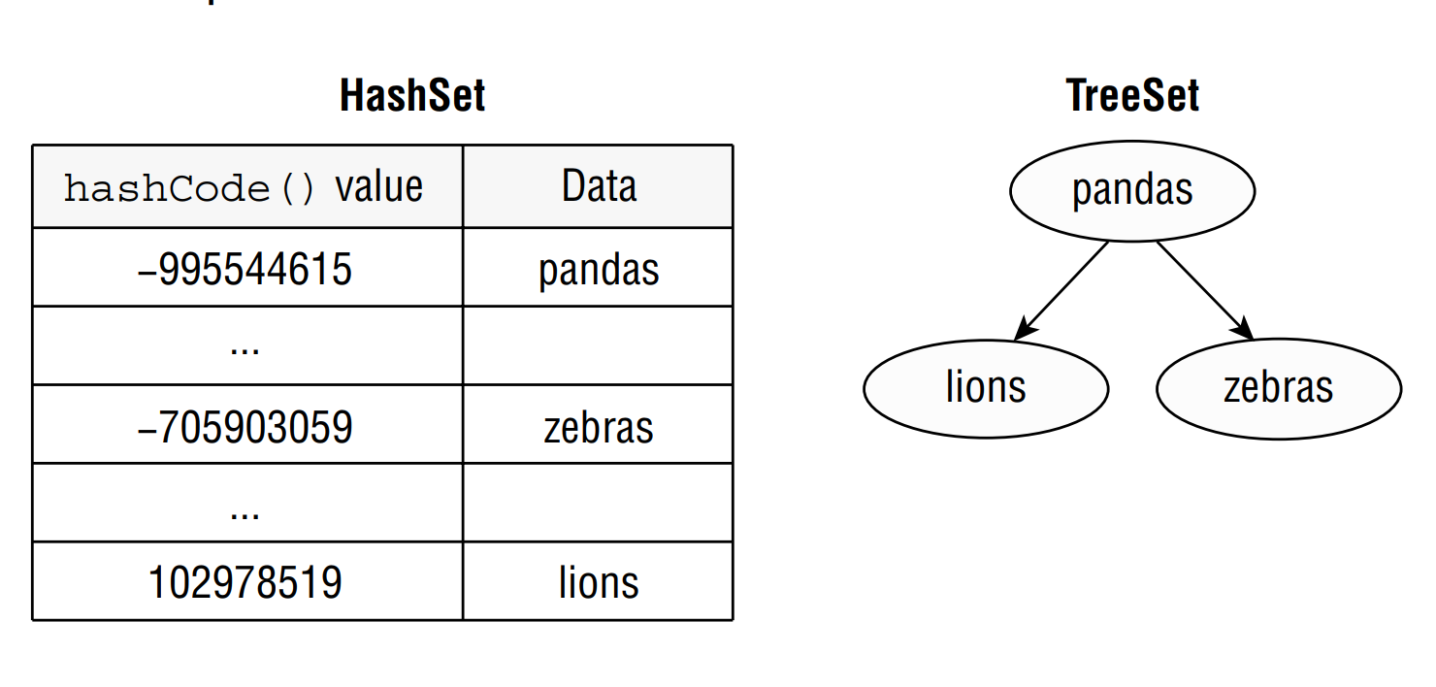
Revision
Using the Set interface
- We use Set when ...
Comparing Set implementations
- HashSet ... in somthing called ... – a datatype that has key as ...
- HashSet uses ... to ... efficiently
– Note: hashCode() won't gurantee ... instead it ... range that ... most ...
- Set has benefit ... constant ... but the ... is not ...
- TreeSet is ... however ... linear ...

Slide 10
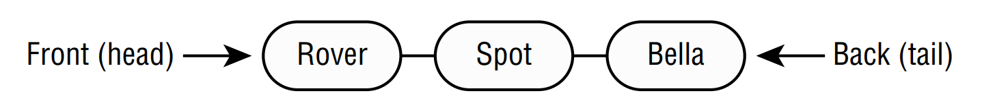
Revision
Working with Set method
- We can create ...
(code illustration snippet 16)
(code illustration snippet 17)
- We use equals() for ... hashCode() will ... Java to look ... without ...
- We have a best case, which is ...
– We have a worst case, which is ...
(code illustration snippet 18)
Using the Queue and Deque interface
- We use Queue when ... order... In general, Queue works...
- This is called FIFO ...
– Deque is ... but ...

Slide 11
Revision
Comparing Deque implementations
- LinkedList also implements....
– However, LinkedList isn't ... as .... We can use ... if we don't need ...
Working with Queue and Deque methods
- Some ... exception ... and return ...
﻿public boolean add(E e)
public boolean offer(E e)
﻿public E element ()
public E peek()
﻿public E remove()
public E poll()

Slide 12
Revision
(code illustration snippet 19)
- Here are ... Deque
﻿public void addFirst(E e)
public boolean offerFirst(E e)
﻿public void addLast(E e)
public boolean offerLast(E e)
﻿public E getFirst()
public E peekFirst()

Slide 13
Revision
﻿public E getLast()
public E peekLast()
﻿public E removeFirst()
public E pollFirst()
﻿public E removeLast()
public E pollLast()
(code illustration snippet 20)
- Other than FIFO, we have ... which is refered to as ...
- We can imagine "stack" as a ...

Slide 14
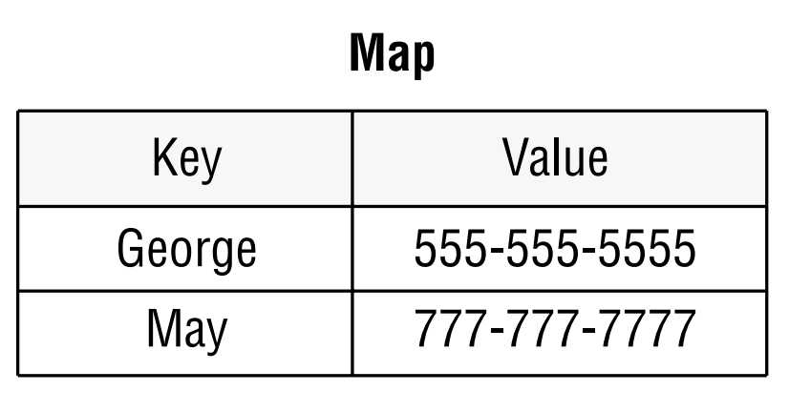
Revision
﻿public void push(E e)
﻿public E pop()
﻿public E peek()
(code illustration snippet 21)
Using the Map interface
- We use Map when ...

Slide 15
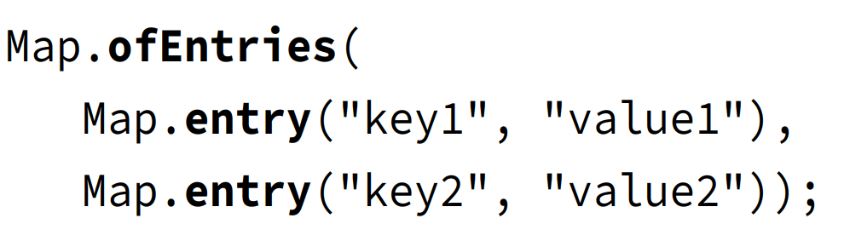
Revision
- We can ... factory ...
﻿Map.of("key1", "value1", "key2", "value2");
- However, this is hard to ... Therefore, we have ...
- Map also have ... method ....
Comparing Map implementations
- HashMap is ... and TreeMap is ...
Working with Map methods

Slide 16
Revision
﻿public void clear()
﻿public boolean containsKey(Object key)
﻿public boolean containsValue(Object value)
﻿public Set<Map.Entry<K,V>> entrySet()
﻿public void forEach(BiConsumer<K key, V value>)
﻿public V get(Object key)
﻿public V getOrDefault(Object key, V defaultValue)
﻿public boolean isEmpty()

Slide 17
Revision
﻿public Set<K> keySet()
public V merge(K key, V value, BiFunction<V, V, V> remappingFunction)
﻿public V put(K key, V value)
﻿public V putIfAbsent(K key, V value)
﻿public V remove(Object key)
﻿public V replace(K key, V value)
﻿public void replaceAll(BiFunction<K, V, V> func)
﻿public int size()
﻿public Collection<V> values()

Slide 18
Revision
Calling basic method
(code illustration snippet 22)
– TreeMap sorts ...
(code illustration snippet 23,24)
Iterating through a Map
- Map also contains ...
(code illustration snippet 25)
- .. shorter ...
(code illustration snippet 26)
- ... even shorter ...
(code illustration snippet 27)
Getting values safely
- get() method will ... if ... Therefore, we want ...
(code illustration snippet 28)

Slide 19
Revision
Replacing values
(code illustration snippet 29)
Putting if absent
- Note: the method putIfAbsent() also ... if the key is ... but ...
(code illustration snippet 30)
Merging data
(code illustration snippet 31)
- merge() also handle the case where ... original ...
(code illustration snippet 32)
- If mapping returns ... then ...
(code illustration snippet 33)

Slide 20
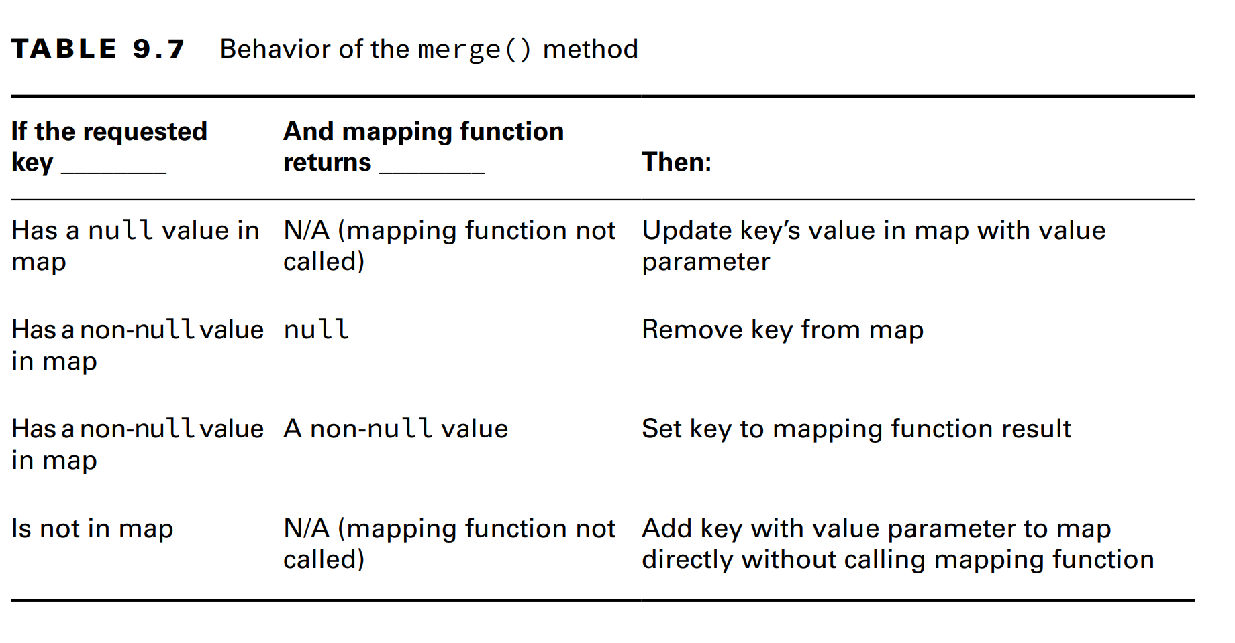

Revision

Slide 21
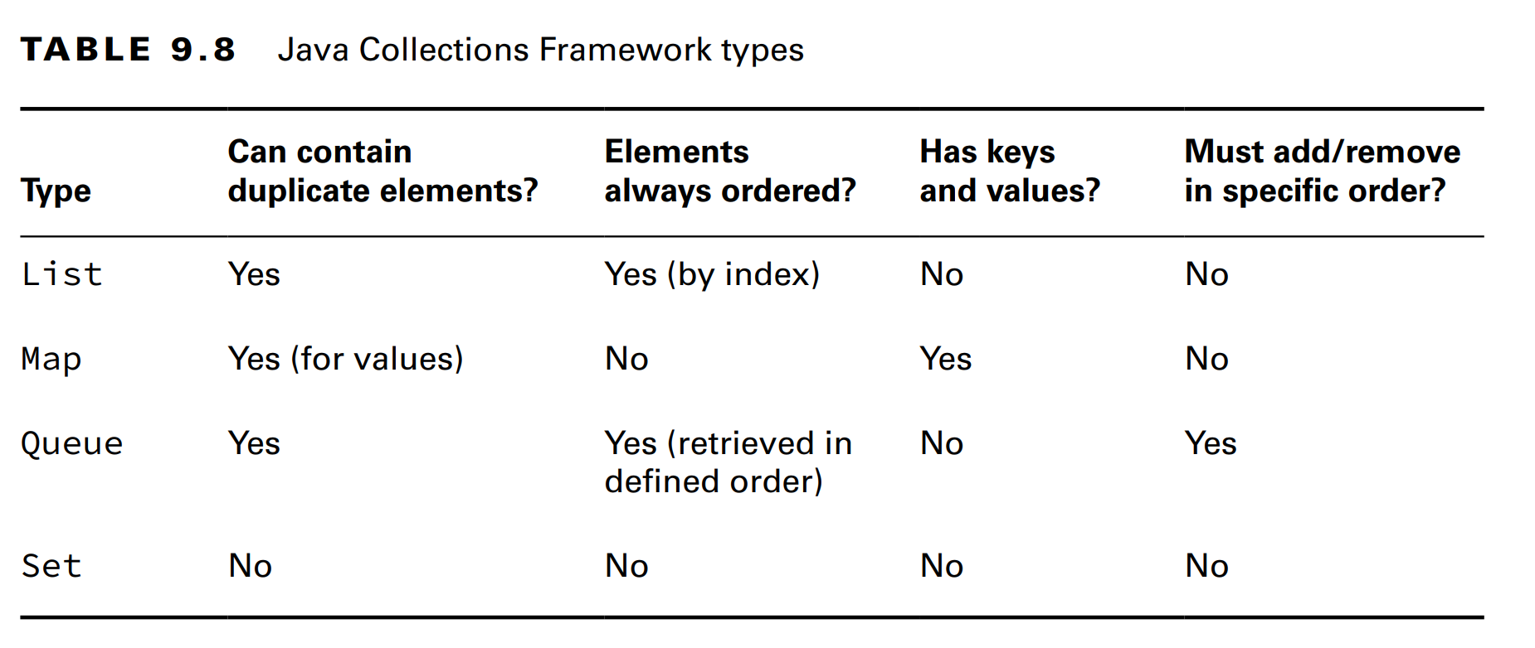
Revision

Slide 22
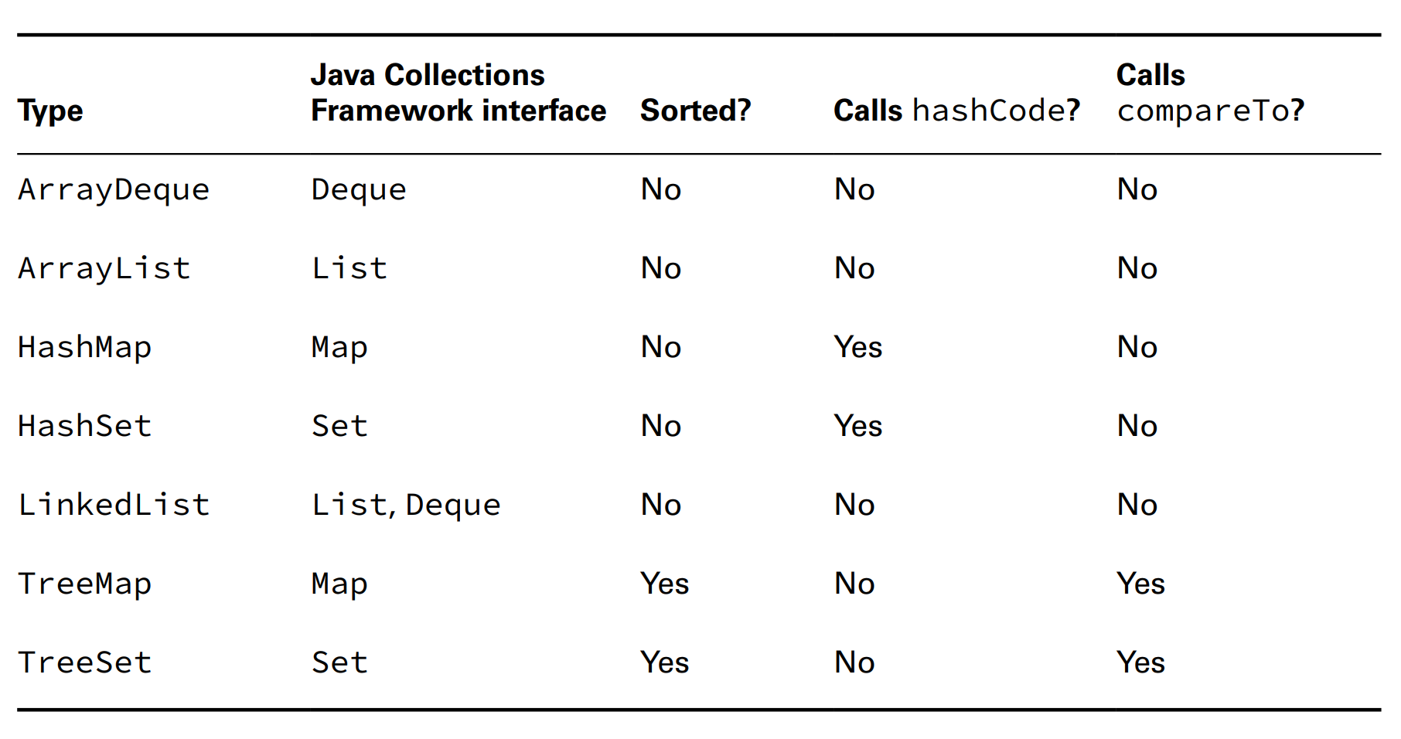
Revision

